Slide 1
DIGITAL LOGIC DESIGN PROJECT
4-Bit Binary
Arithmetic Calculator
Batch Number:1
Thummeti Teja-2620030003
Prakash Machgaiya-2620030067
Ananya Malkapuram-2620030060
Sai Lakshmi Harshini Pemmaraju-2620030063
01

Slide 2
INTRODUCTION
Why Digital Arithmetic Circuits Matter
Every processor, microcontroller, and calculator ultimately depends on circuits that can add and subtract binary numbers. Arithmetic Logic Units (ALUs) built from basic gates — XOR, AND, OR, multiplexers, and full adders — form the computational core of digital systems.
DOMAIN
•
Digital Electronics / Computer Architecture
CORE CONCEPT
•
Binary Addition, 2's Complement Subtraction
This project implements a 4-bit binary arithmetic calculator capable of performing addition and subtraction on two 4-bit operands, using 2's complement logic controlled by a single mode-select line.
BUILDING BLOCKS
•
XOR gates, 2:1 MUX, Full Adders
APPLICATION
•
ALU design, embedded & processor datapaths
02

Slide 3
The Need for a Unified Add/Subtract Unit
1
Separate Circuits Waste Resources
2
No Single Control Line
Using distinct adder and subtractor circuits for the same 4-bit operands duplicates hardware unnecessarily.
Without a shared mode-select mechanism, switching between addition and subtraction requires manual rewiring or separate modules.
3
Carry Propagation Delay
4
Limited Scalability
A simple bit-by-bit approach does not scale efficiently; a structured ripple-carry chain is needed for correctness across all 4 bits.
An ad-hoc design cannot be easily extended to wider operand sizes or additional arithmetic modes.
03

Slide 4
Goals of the Project
1
Design a 4-bit combinational circuit that adds two binary numbers A and B.
2
Extend the adder to perform subtraction using 2's complement representation.
3
Implement a single mode-select control (Add/Sub) using XOR gates and 2:1 multiplexers.
4
Build a 4-bit ripple-carry chain of full adders with a shared carry-in (Cin).
5
Verify correct operation through truth tables and simulation for all input combinations.
6
Demonstrate a foundational building block used in real ALUs and processor datapaths.
04

Slide 5
LITERATURE SURVEY / EXISTING SYSTEM
Prior Approaches and Their Limitations
Approach
Description
Limitation
Half Adder Based Design
Adds only two single bits with no carry-in support
Cannot be chained for multi-bit addition
Separate Adder & Subtractor
Independent circuits for addition and subtraction
Higher gate count, no shared control line
Serial (Bit-Serial) Adder
Processes one bit per clock cycle using a single full adder
Slow — unsuitable for real-time calculation
Basic Ripple-Carry Adder
Chains full adders for multi-bit addition only
No native subtraction; carry delay grows with width
05

Slide 6
PROPOSED SYSTEM
A Unified Add/Subtract Calculator
The proposed circuit accepts two 4-bit inputs, A and B, and a mode-select signal. XOR gates conditionally invert each bit of B, and 2:1 multiplexers route either B or its complement into a 4-bit ripple-carry adder, with the mode line also feeding the initial carry-in.
IMPROVEMENT OVER EXISTING SYSTEM
1 circuit, 2 operations
vs. two separate circuits
1 control bit
Single control line switches between addition and subtraction
vs. manual reconfiguration
2's complement subtraction — no separate subtractor hardware
Parallel ripple-carry
4-bit ripple-carry chain with shared Cin for correct multi-bit sums
vs. slow bit-serial processing
Output-stage multiplexer selects the active result mode
Extensible design
scales to 8-bit, 16-bit ALUs
06

Slide 7
SYSTEM ARCHITECTURE
Block Diagram — Signal Flow
Mode Select
(Add/Sub)
Input A
(4-bit)
XOR + 2:1 MUX
(Complement Logic)
4-bit Ripple
Carry Adder
Output MUX
(Result Select)
4-bit
Output
Input B
(4-bit)
A and B feed the complement-logic stage, where the mode line optionally inverts B for subtraction. The (possibly complemented) B, along with A and the propagated carry-in, drive a 4-bit ripple-carry adder. The output multiplexer, also driven by the mode signal, selects the final 4-bit result.
07

Slide 8
METHODOLOGY / IMPLEMENTATION
Design Steps and Working Principle
1
Define Inputs
Two 4-bit binary numbers A[3:0] and B[3:0], plus a mode-select and Cin control signal.
2
Complement Stage
Each bit of B is XORed with the mode signal; a 2:1 MUX selects between B and B' per bit.
3
Ripple-Carry Addition
Four full adders are chained — each stage's carry-out feeds the next stage's carry-in.
4
Result Selection
An output multiplexer, driven by the mode line, selects the final 4-bit arithmetic result.
08

Slide 9
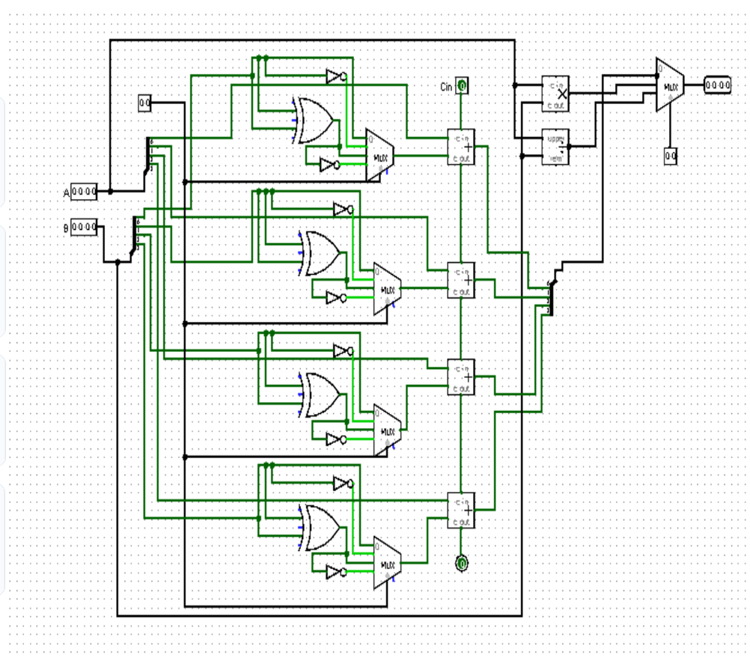
RESULTS AND DISCUSSION
Functional Verification via Truth Table
Sample Truth Table — Single-Bit Stage (A, B, Cin → Sum, Cout)
A
B
Cin
Sum
Cout
0
0
0
0
0
0
0
1
1
0
0
1
0
1
0
0
1
1
0
1
1
0
0
1
0
1
0
1
0
1
1
1
0
0
1
1
1
1
1
1
09

Slide 10
CONCLUSION
Summary and Achievements
1
Successfully designed a 4-bit binary calculator performing both addition and subtraction with a single mode-select line.
2
Demonstrated 2's complement subtraction using XOR gates and 2:1 multiplexers, avoiding duplicate hardware.
3
Verified correct carry propagation across a 4-bit ripple-carry adder chain through truth-table analysis.
4
All stated objectives were met, producing a compact, extensible building block applicable to larger ALU designs.
Thank You
10

